Slide 1
Progress Tracker
Task Manager & Progress Tracker
Presented By:
Tushar Jaiswal - United College of Engineering and Research - Department of Computer Science & Engineering

Slide 2
OUTLINE
Problem Statement
System Development Approach
Algorithm & Deployment
Result
Conclusion
Future Scope
References

Slide 3
Problem Statement
Students and professionals often struggle with managing multiple tasks, deadlines, and priorities effectively.
Existing task management applications are either too complex or lack personalized progress tracking.
There is a need for a lightweight, easy-to-use, and visually appealing task manager that helps users organize tasks by category, priority, and completion status while tracking their overall progress interactively.

Slide 4
System Approach
Frontend Technologies:
HTML5 – Structure of the application
CSS3 – Styling, layout, and responsive design
JavaScript – Dynamic interactivity and logic
Design Approach:
Simple, clean, and user-friendly interface
Mobile-responsive layouts
Dark & Light mode support
Modular separation of HTML, CSS, and JS
LocalStorage for task persistence

Slide 5
Algorithm & Deployment
1. Task Creation
- User inputs title, category, priority, deadline, description, and purpose.
2. Task Rendering
- Dynamically display tasks in list view.
- Filter by Active, Completed, or All tasks.
3. Interactivity
- Mark tasks as complete/incomplete.
- Edit or delete tasks.
- Track progress (overall, category-wise, priority-wise).
- Display motivational messages based on progress.
4. Data Persistence
- Save and retrieve tasks using LocalStorage.
5. Deployment
- Host on GitHub Pages / Netlify for free access.

Slide 6
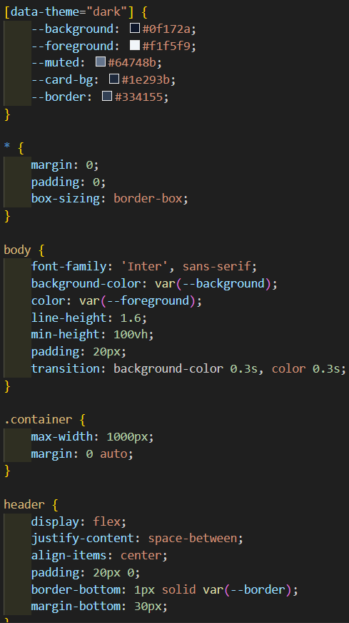
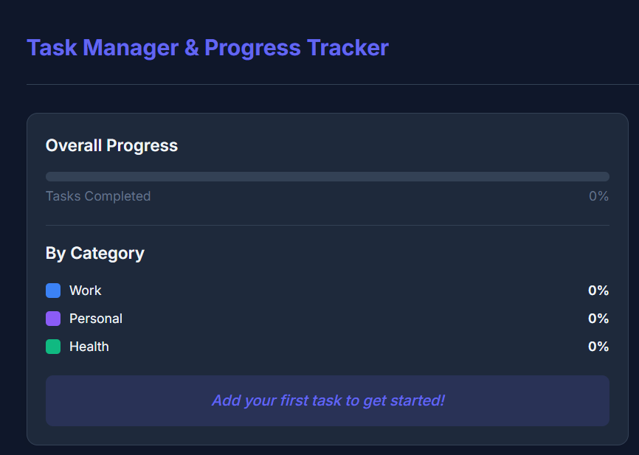
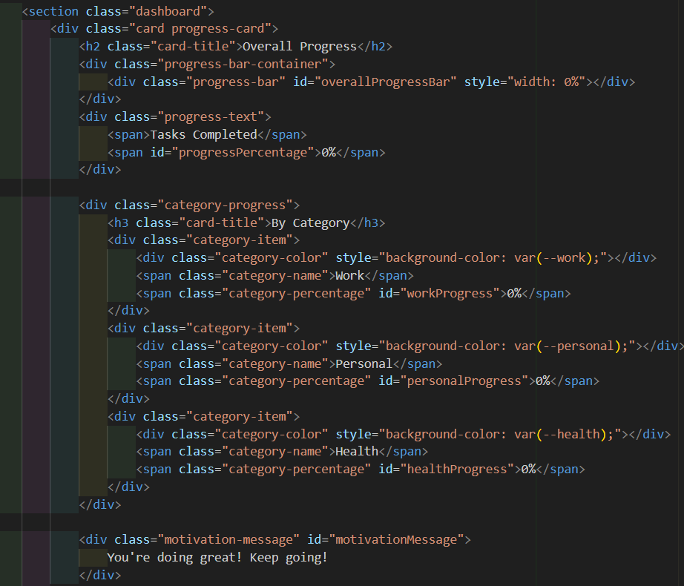
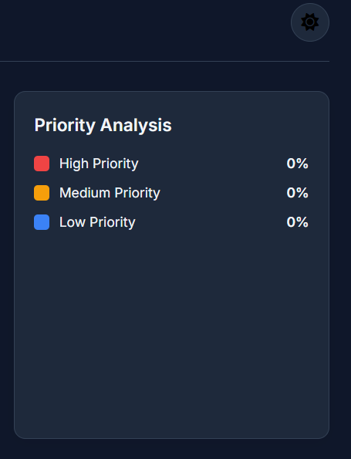
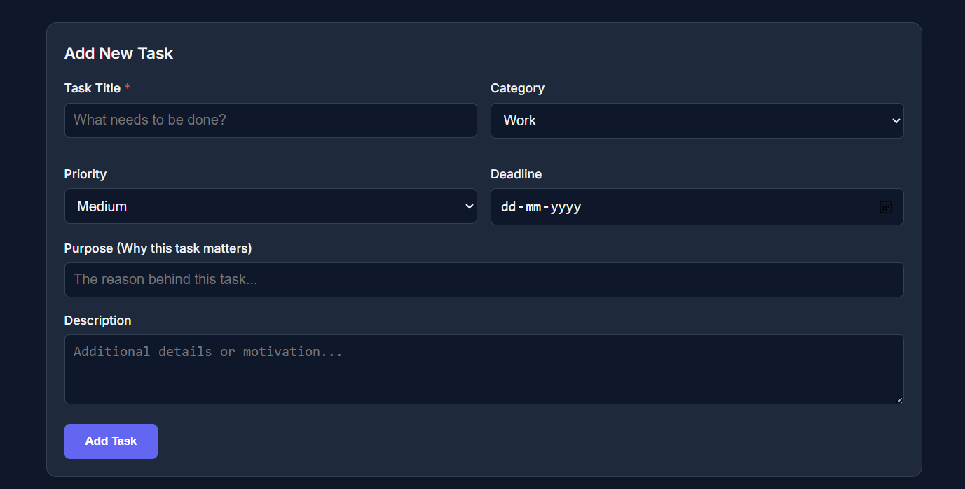
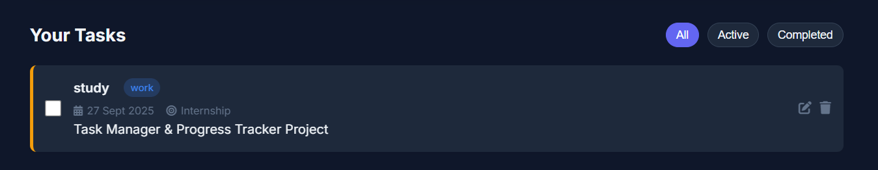
Result
- Successfully developed a Task Manager with:
- Add, Edit, Complete, and Delete functionality
- Progress tracking (Overall, Category-wise, Priority-wise)
- Dark and Light mode support
- Interactive motivational messages
- GitHub Repository:
https://github.com/tjaiswal2003/Task-Manager-Progress-Tracker

Slide 7
Conclusion
Provides an effective way to manage tasks with deadlines and priorities.
Enhances productivity by tracking progress interactively.
Offers a clean, responsive, and user-friendly design.
Eliminates dependency on complex task management applications.

Slide 8
Future scope
Add backend integration with database (Node.js, MongoDB).
Implement user authentication for multi-user support.
Enable notifications and reminders for deadlines.
Provide analytics dashboard with task completion trends.
AI-based suggestions for task prioritization.

Slide 9
References
MDN Web Docs (HTML, CSS, JavaScript)
W3Schools Tutorials
Tailwind CSS Documentation
Bootstrap Documentation
GitHub Pages / Netlify Hosting

Slide 10
THANK YOU

